Slide 1


COVID-19: The New Normal
RETURN TO CAMPUS GUIDELINE
FOR MMU STUDENTS
Version : 06-OCT-2020

Slide 2
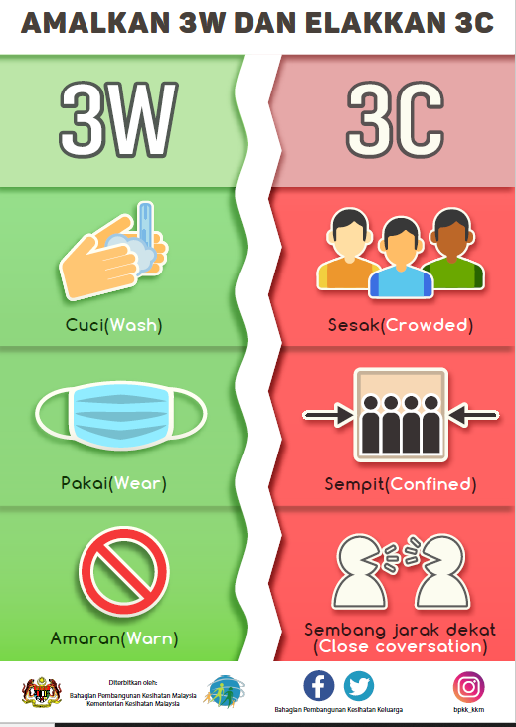
General Guidelines
In general, the New Normal consists of the following for all activities and all venues:
Need to complete 2 doses of vaccination
Required to do covid-19 self test upon arrival at the campus
Temperature screening
Self Check-In using MySejahtera Apps
Use MMU Mobile Apps to record entering different premises
Hygiene measures – use of soap and hand sanitizers
Cleaning and disinfection at all venues where activities are conducted
Wearing of face mask is mandatory on campus
Physical distancing of at least 1m apart
It is important that all students take responsibility for their own health & safety by practicing good hygiene, put on face mask and frequently wash or sanitize their hands.

Slide 3
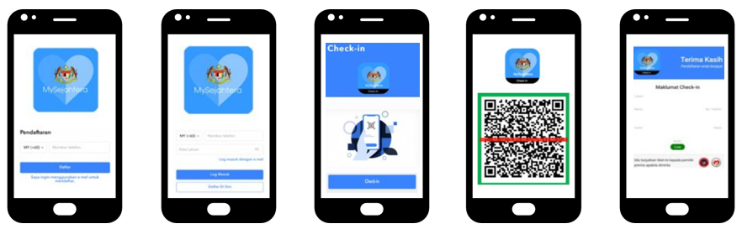
Guideline for Check-In at MMU Premises
How to check in using MySejahtera
01
02
03
04
05
Register with MySejahtera
Log into MySejahtera
Press the Check- In Button
Scan QR Code of the premise
Show report to the premise guard/owner

Slide 4
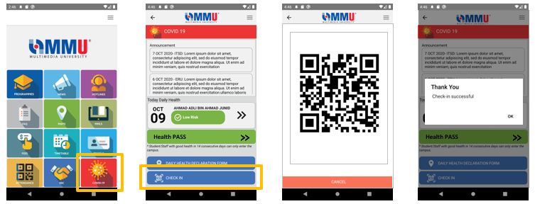
Guideline for Check-In Inside Campus Area
How to record your visit using MMU Mobile Apps
01
02
03
04
Go to your students MMU Mobile Apps & Select COVID 19 in the menu
Select Check-In button
Scan the QR Code provided at the premise
Your check-in is successfully recorded

Slide 5
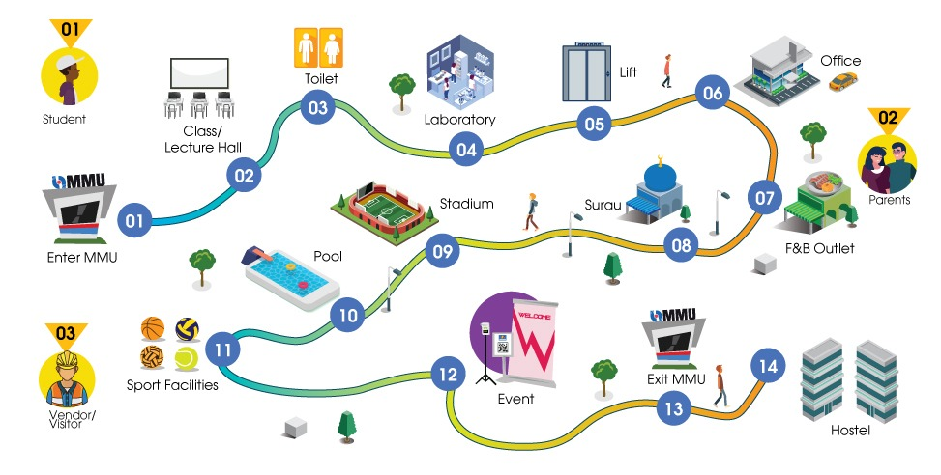
Safe Journey Guideline in MMU Campus

Slide 6
Guideline Contents
Student
General Guidelines for Students
01
03
Guidelines For
Using Toilet
07
Guidelines At The Cafeteria / F&B Outlets
11
Guidelines At The Gym/ Sports Facilities
Parents
Toilet
F&B
Outlets
Sports
Facilities
02
General Guidelines for Parents
Guidelines In The Laboratory
Guidelines When Using Surau
Guidelines For Students’ Events/ Gathering
Visitors/Vendor
04
08
12
General Guidelines for Visitors/Vendors
03
Laboratory
Surau
Gathering
05
Guidelines When Using Lift
09
Guidelines At The Stadium/ Sports Centre
13
Guidelines When Exiting Campus
01
Guidelines When Entering Campus / Guard House
Lift
Stadium
Exit MMU
Enter MMU
Guidelines In Classes /Lectures Hall /Library
Guidelines At MMU’s Offices / Meeting Room
Guidelines At The Swimming Pool
Guidelines At The Hostel
02
06
10
14
During Class
Office
Pool
Hostel

Slide 7

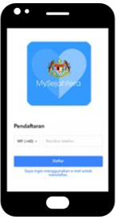

01
General Guidelines for Students
Upon Arrival
at the Campus
In the Campus
SOP Checklist
In the Campus:
Usage of face mask is COMPULSORY in classrooms/ laboratories/ library/ auditoriums/ any other crowded place
Sanitise your hands regularly (automated hand sanitisers are provided)
Maintain a social distance at all times (markers & signages are available to guide you)
COMPULSORY for Students to do 1st check- in using MySejahtera once at the entrance on the buildings
Subsequently students are advice to use MMU Mobile Apps check-in to record visit at different premises

Slide 8
02
General Guidelines for Parents
Upon Arrival at the Campus:
SOP Checklist
In the Campus:
Ensure you check-in via MySejahtera at every location: classroom / laboratories / auditoriums
Usage of face mask is COMPULSORY in classrooms/ laboratories/ library/ auditoriums/ any other crowded place
Sanitise your hands regularly (automated hand sanitisers are provided)
Maintain a social distance at all times (markers & signages are available to guide you)
Disposed used face mask in the bins provided
Please Check-in using MySejahtera app and record your temperature at thermal scanners

Slide 9
03
General Guidelines for Visitors/Vendors
Upon Arrival at the Campus:
SOP Checklist
In the Campus:
Ensure you check-in via MySejahtera at every location: classroom / laboratories / auditoriums
Usage of face mask is COMPULSORY in classrooms/ laboratories/ library/ auditoriums/ any other crowded place
Sanitise your hands regularly (automated hand sanitisers are provided)
Maintain a social distance at all times (markers & signages are available to guide you)
Disposed used face mask in the bins provided
Vendors who has been awarded projects in MMU, is encouraged to submit their documents via online ( OSHE unit) for document verification and safety briefing appointment.
Please Check-in using MySejahtera app and record your temperature at thermal scanners

Slide 10
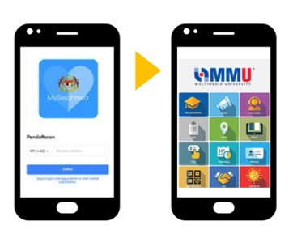




01
Guidelines When Entering Campus
COMPULSORY for Students to do 1st check- in using MySejahtera once at the entrance on the buildings
Subsequently students are advice to use MMU Mobile Apps check-in to record visit at different premises
ALWAYS practice..
Always wear mask (Compulsory)
Keep physical distancing
Wash hand with soap
Sanitize hand

Slide 11
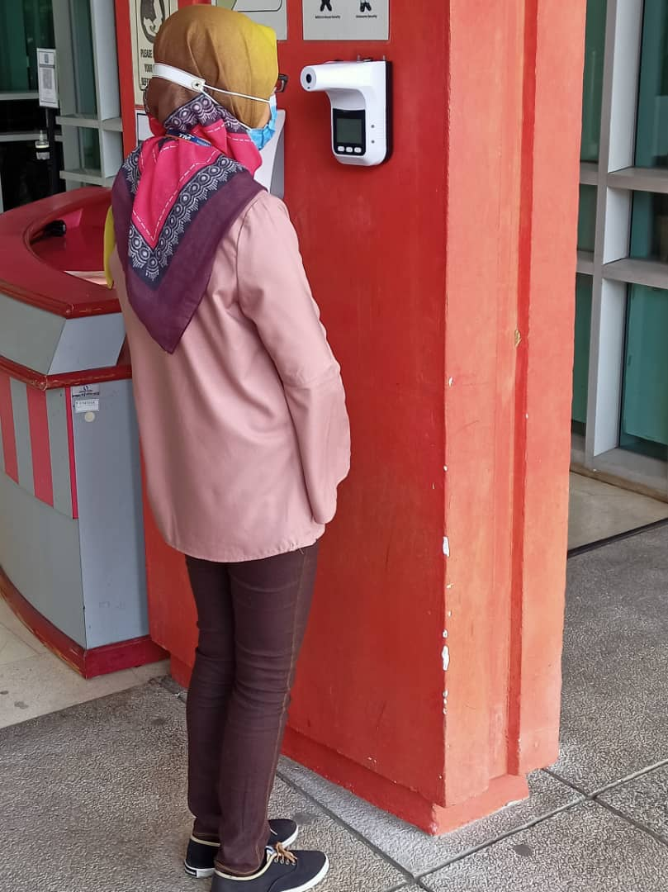
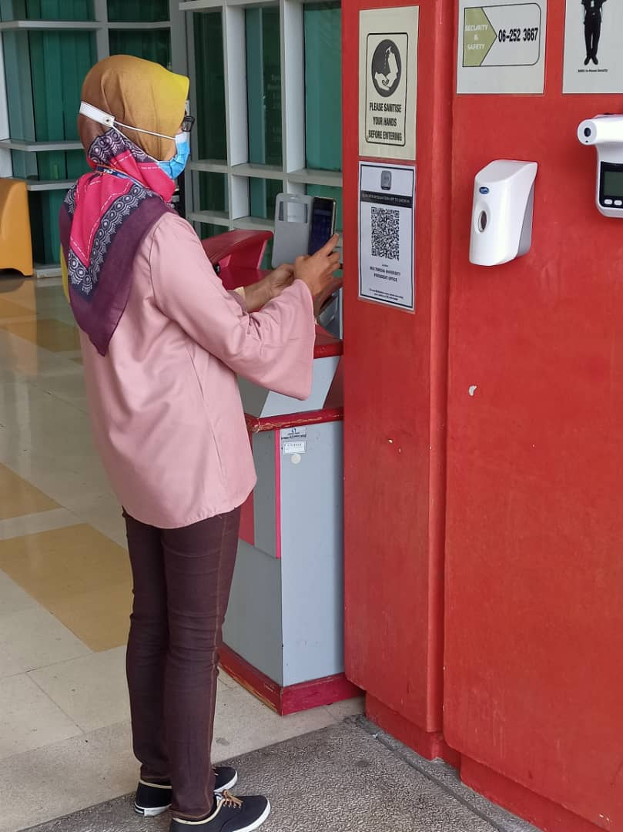
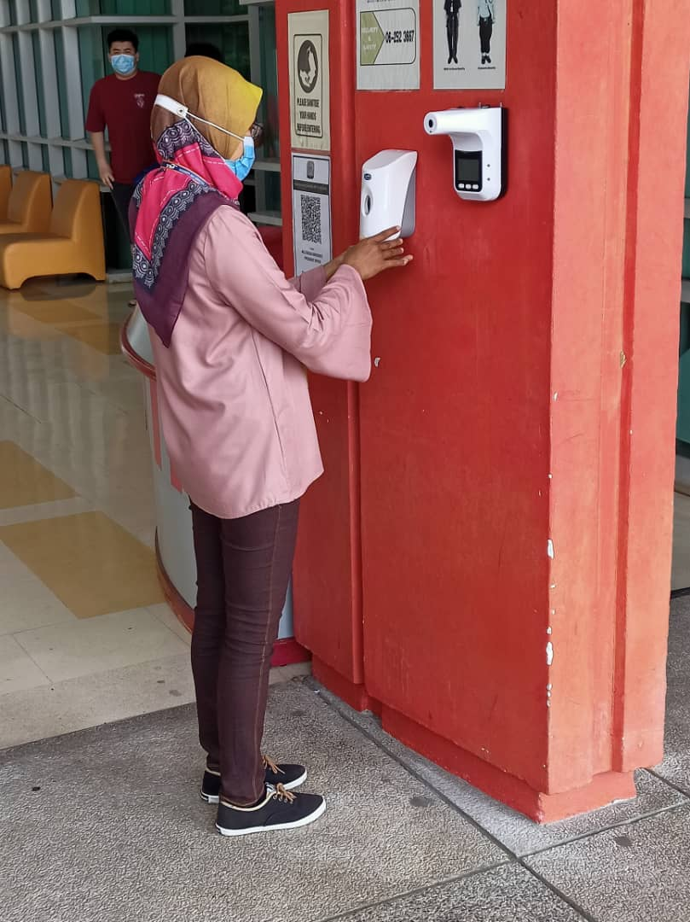
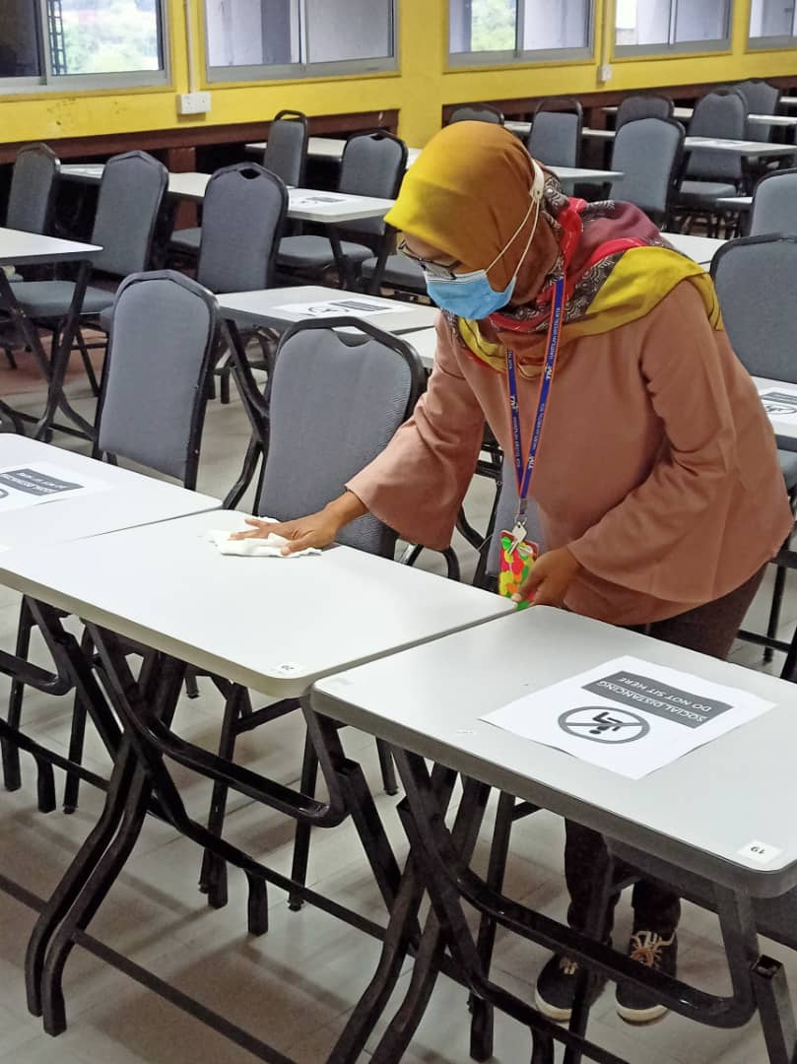
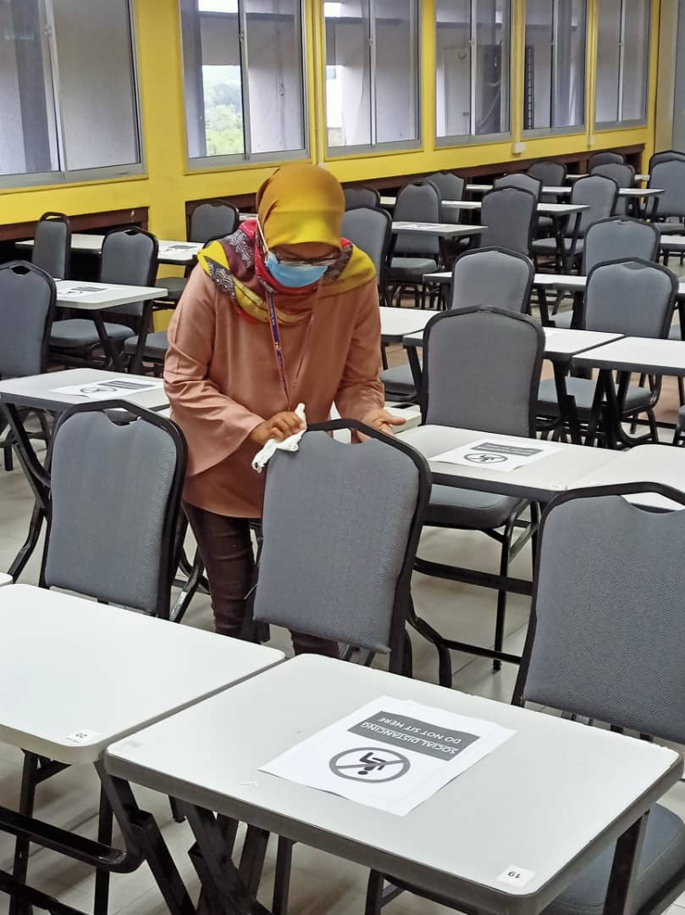


02
Guidelines In Classes /Lecture Halls /Library
Step 1: Student to sanitise their hands and take body temperature in front of the building.
Step 2: Student to scan the QR code on their MMU Mobile App as provided in front of the building.
Step 3: Student to sanitize their hands before entering the classroom.
Step 4: Student are advised to sanitize their chair and table before leaving the class.
Tables and chairs are marked for physical distancing in classrooms and lecturer rooms and students are to adhere to the rules
ALWAYS practice..
DO NOT remove the markers on the tables and chairs when you are attending the class/ library
Wear mask
Avoid over crowded
Keep physical distancing

Slide 12
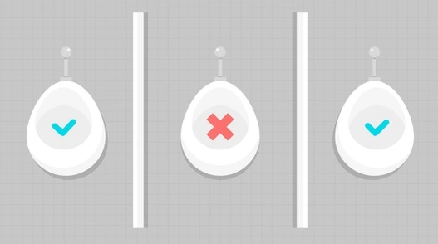

03
Guidelines For Using Toilet
ALWAYS practice..
Wear mask
before
entering toilet
Wash hands and avoid touching surfaces
There is a maximum capacity for all washrooms at the campuses. Some wash basins have been deactivated to ensure social distancing between the users.
Use soap before and after usage of toilet’s equipment
Use Disinfectant

Slide 13


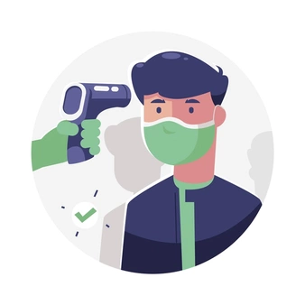
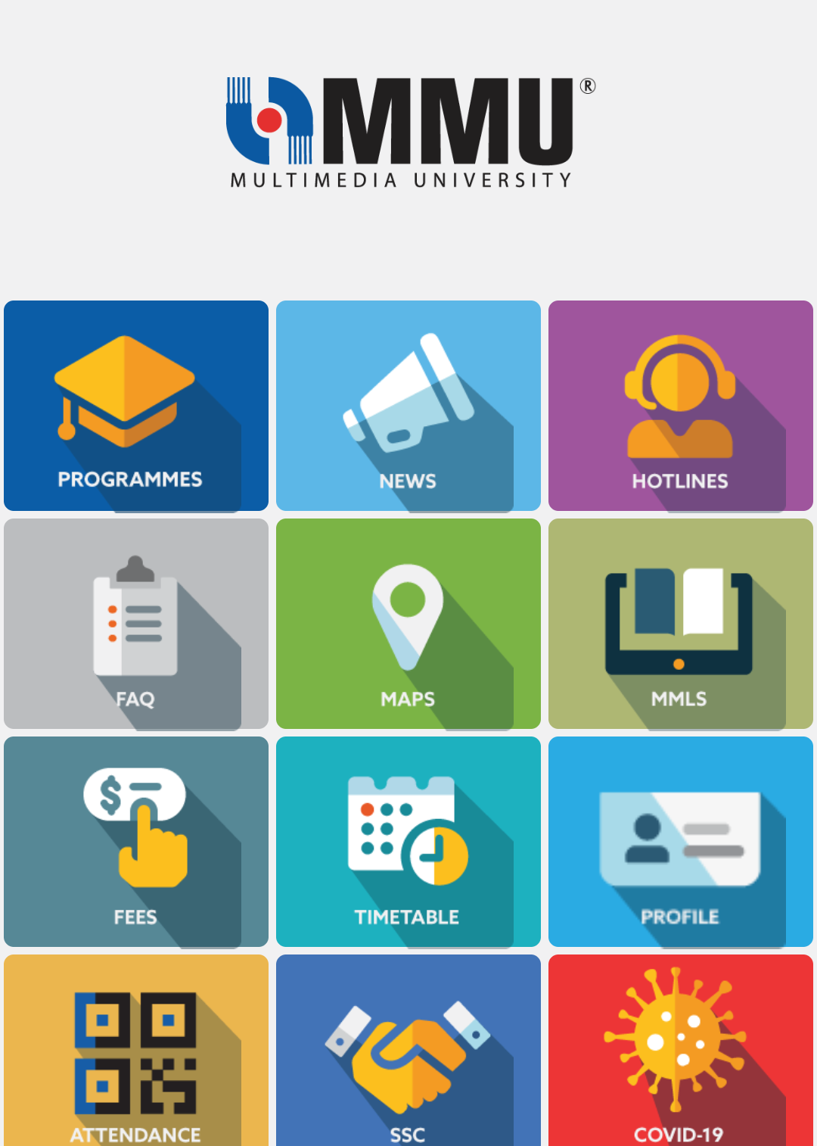


04
Guidelines In The Laboratory
BEFORE Entering Laboratory/Research
Prior to entering a laboratory/ workspace, student is required to show to Approval Letter issued by the faculty.
Fill up the Attendance Logbook designated at the laboratory/ workspace with required information as Full name, Student ID, Contact phone number, Date, Time In/Out, Location, Purpose of activities undertaken.
Ensure to record your visit with MMU Mobile Apps Check-In. Scan the QR Code provided
Students must ensure that they do not have any symptoms; runny nose, continues cough, high fever and sore throat.
ALWAYS practice..
Always wear mask
Keep physical distancing
AFTER Laboratory/Research Activity is Completed
All users must record their check out time at the Attendance Logbook when leaving the lab.
All users have to sanitize your hand before leaving the laboratory/ workspace.
Faculty laboratory engineer/ technician have to arrange and carry out cleaning and sanitization processes before and after each laboratory/research activity is done.
FOR RESEARCH STUDENT
Student is to obtain the Approval Letter from the faculty where your research activities (require special equipment's) to be undertaken in the laboratory with the recommendation from your supervisor(s) and approved by the Dean of the Faculty.
Wash hand with soap
Sanitize hand

Slide 14
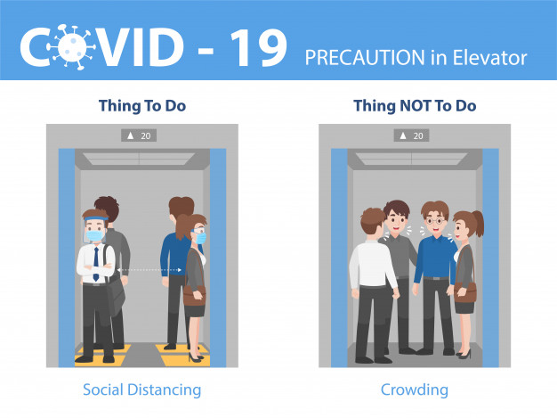


05
Guidelines When Using Lift
ALWAYS practice..
Wear mask
before
entering the lift
Avoid over crowded in the lift
Keep physical distancing
All lifts at MMU campuses have a maximum capacity of 4 persons per trip. Kindly follow the standing positions as indicated on the floor to maintain the social distance while in the lifts.
OR
Students may opt using stairs with precaution
Don’t shake
Use sanitizer after using the lift / stairs

Slide 15
06
Guidelines At MMU’s Offices/Meeting Room
ALWAYS practice..
Ensure to record your visit with MMU Mobile Apps Check-In. Scan the QR Code provided
Meeting attendees must ensure that they do not have runny nose, continues cough, high fever and sore throat.
Wear mask
before
entering the lift
Avoid over crowded in the lift
Keep physical distancing
Don’t shake
Sanitize your hand before entering & after use of meeting room

Slide 16


07
Guidelines At The Cafeteria / F&B Outlets
ALWAYS practice..
Ensure to record your visit with MMU Mobile Apps Check-In. Scan the QR Code provided
Wear mask before entering the cafeteria
Not encouraged to talk to each other
Keep physical distancing
Tables & chairs at the cafeteria have been re-arranged to accommodate a limited capacity. Kindly follow the markers on the tables and do not rearrange the tables / chairs while using the cafeteria.
Wash hand using soap before purchasing any meal
Use sanitizer after using the lift / stairs
Are advised against touching any surfaces if it is not necessary

Slide 17

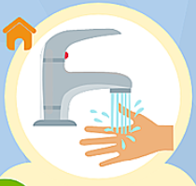

08
Guidelines When Using Surau/Prayer Room
Ensure to record your visit with MMU Mobile Apps Check-In. Scan the QR Code provided
ALWAYS practice..
Take wudu’ from home/ hostel
Always wear
mask
Keep 1(one) meter physical distancing
Bring your personal prayer mat, and telekung for ladies
Don’t shake before and after prayer
Sanitize your hand before entering & after use of prayer room
Please disperse immediately and quietly after each prayer.

Slide 18


09
Guidelines At The Stadium/Sports Centre
Ensure to record your visit with MMU Mobile Apps Check-In. Scan the QR Code provided
ALWAYS practice..
Mandatory Body Temperature Scan upon arrival
Smoking is strictly prohibited
To wear a face mask when not playing and exiting the sports centre
To reduce physical interactions among players before, during and after sports activity
Strictly a maximum of 30 participants is allowed at one time at the sports centre
Sanitize using hand sanitizer provided at the entrance
Keep physical distancing
No sharing of personal equipment (drinking water bottles, food, clothing, face towels , personal belongings etc.) & must be taken back when leaving the MMU sports centre.
Unhygienic practices such as spitting and peeing at the sports centre is strictly PROHIBITED.
*subject to latest guidelines provided by MKN/ KKM/ MOHE/ KBS and other government agencies

Slide 19

10
Guidelines At The Swimming Pool
To strictly adhere to all “Protokol Am Individu” for SOP Sukan Rekreasi listed in MKN and KKM SOPs.
To bring your own swimming equipment (goggles, caps, board etc.) and personal equipment (water bottle, clothes, towels etc.).
  No sharing of swimming/personal equipment is allowed. All swimming/personal equipment must be taken when leaving the swimming pool complex. No privately-owned equipment will be kept in the swimming pool complex.
To utilise enclosed public facilities responsibly. Toilets and changing rooms are available for three (3) users at one time. No waiting and/or showering allowed to minimize congestion in an enclosed space. Students can use the outdoor shower before entry into the pool and after exiting the pool.
To keep a physical distance of at least three (3) meters apart in the pool from other swimmers at all times.
To utilise the pool within the maximum limit of one (1) hour per session.
To ensure parents/guardian/family to drop off students because ONLY participants are allowed into the swimming pool complex.
  NO parents/family or accompanying persons are allowed to enter and wait inside the swimming pool complex.
To refrain from using and entering areas that have been cordoned off due to social distancing measures, including the baby pool.
To ensure that no food and drinks are consumed/brought into the swimming pool complex.
To monitor students and stop them from unhygienic practices such as spitting and peeing in the swimming pool.
To refrain from smoking inside and outside the swimming pool complex. The university campus is a NO-Smoking Zone and non-compliance will result in a fined.
To strictly adhere to instructions from the university-appointed lifeguard on-duty.
ALWAYS practice..
To complete the registration before entry into the swimming pool complex
Ensure to record your visit with MMU Mobile Apps Check-In. Scan the QR Code provided
Wear mask
when not in the pool
Keep physical distancing
Students must ensure that they do not have runny nose, continues cough, high fever and sore throat.
To strictly follow the limit on number of students at any one time in the swimming pool. (A maximum of 20 people).
Sanitize your hand before entering pool complex
*subject to latest guidelines provided by MKN/ KKM/ MOHE/ KBS and other government agencies

Slide 20

11
Guidelines At The Gym/Sports Facilities
GENERAL PROCEDURES
Please ensure your workout/ game attire is already on (to minimize spending time to change your attire)
Please wear face mask before and after the activities.
Minimize long conversation while conducting the activities/tournaments.
No sharing of personal equipment e.g. drinking bottle, face towel & etc.
Unhygienic practices such as spitting and peeing are strictly PROHIBITED.
Disposed used face mask in the bins provided
Make sure to leave the premises as soon as possible after the activity/ tournaments is finished.
Please report to staff on duty before or after finish the session.
General SOPs by National Security Council and Ministry of Health are applicable.
PERMITTED ACTIVITIES
All contact and non-contact sports/recreation are ALLOWED.
For tournaments, only local tournaments are ALLOWED. International level tournaments are NOT ALLOWED.
Tournaments with spectators are NOT ALLOWED.
Tournaments and competitions must be conducted in a controlled environment by owner of premises which is by MMU as well as the organizer.
Kindly refer to SOP by Ministry of Youth and Sport for further details.
General SOPs by National Security Council and Ministry of Health are applicable.
Students are advised to bring along their own…
Own Equipment's (Preferable)
Own Towel
Own Hand Sanitizer
A Bottle of Water
Own mat (if necessary for your workout)
Kindly show proof of your booking to the officer in charge before using the sport facilities.
MMU GYM OPERATION HOURS
(Monday to Friday)
MALE
Monday 2.00 pm – 5.00 pm
Friday 2.30 pm – 5.30 pm
Wednesday 2.00 pm – 7.00 pm
FEMALE
Tuesday 2.00 pm – 5.00 pm
Thursday 2.00 pm – 7.00 pm
Note: Only 3 sessions (1 hour per session) are provided each day
Limited to 10 users per session
Kindly read and understand the sports facilities booking rules and regulations.
Ensure to record your visit with MMU Mobile Apps Check-In. Scan the QR Code provided
All users will have to undergo temperature check before using or conducting their activities
*subject to latest guidelines provided by MKN/ KKM/ MOHE/ KBS and other government agencies

Slide 21

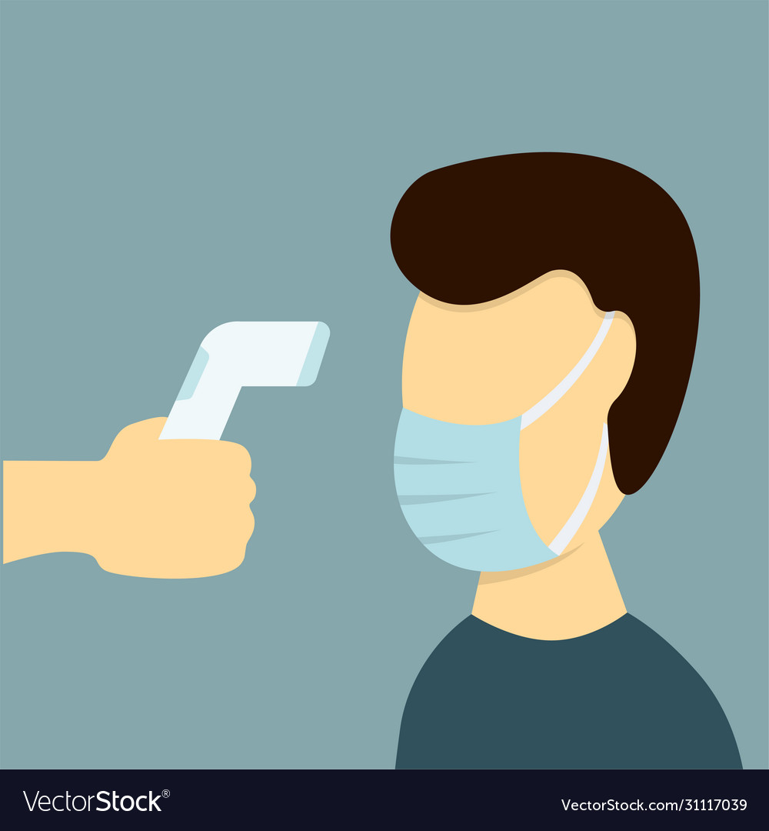
12
Guidelines For Students’ Event/Gathering
ALWAYS practice..
Advice
All gathering and event is as per advice by the Ministry of Health (MOH)
Students are encouraged to leverage digital facilities such as live broadcast, online meeting, teleconference, webinar, E-learning and others.
Usage of MySejahtera & MMU Mobile App
Check your body temperature
Always wear mask
Avoid crowd places
Keep physical distancing
Use soap to wash hand
Use sanitizer
Smoking is strictly prohibited in campus

Slide 22
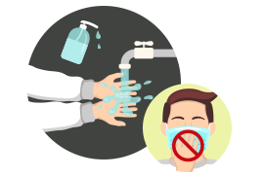
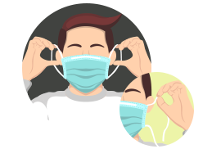
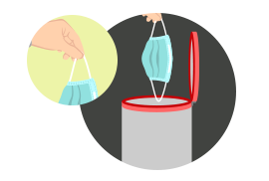
13
Guidelines When Exiting Campus
When exiting the campus and you want to dispose your mask, please follow this steps, do not litter.
ALWAYS practice..
1. Make sure you wash your hands thoroughly, or clean your hands with an alcohol-based hand sanitizer.
Wear a
3 layer mask
Avoid crowd places
Keep physical distancing
2. With clean hands, hold on to the straps or loops of your mask at your ear.
Use sanitizer
You are encouraged to check your body temperature before leaving campus compound
3. Discard your mask into an enclosed bin. Do dispose your mask by holding onto the straps only.

Slide 23
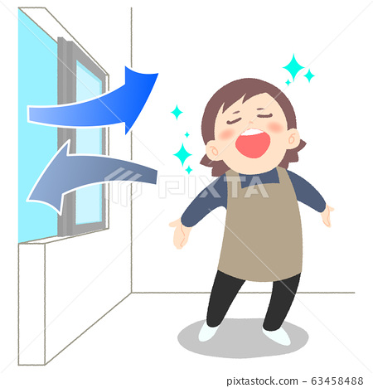

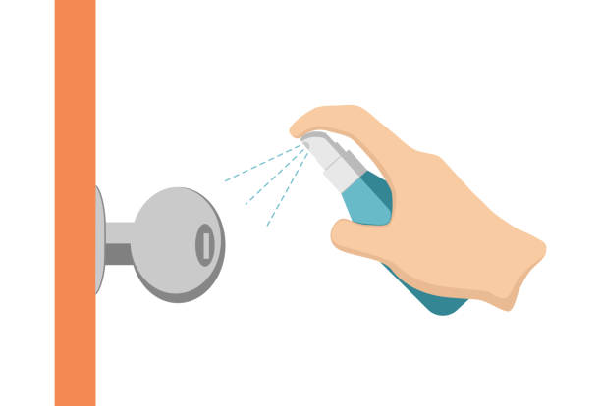

14
Guidelines At The Hostel
Always keep your hostel room clean
Sanitize your room doorknob and usage of disposable gloves is encouraged.
Always wear face mask when you are going out of your hostel compound
Keep your room ventilated
If you have any symptoms of core throat, runny nose, continues dry cough and high fever, you are advised to contact hostel warden or student affairs Officer
Remember to practice physical and social distancing when you are in hostel.
Practice to carry personal sanitizer when going in and out of hostel.
Always wash your hands with soap and sanitizers provided
Dispose the used face mask in the bins provided.

Slide 24
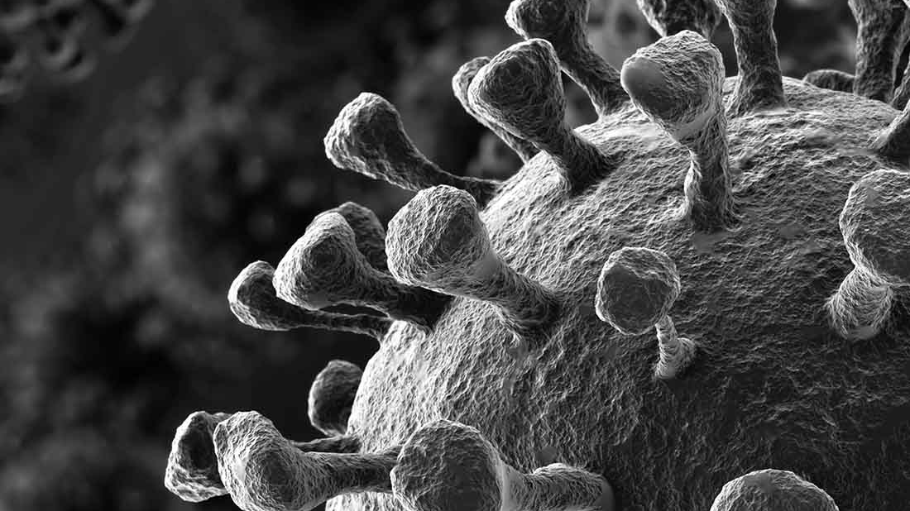

In case of COVID-19 outbreak in MMU campus , please refer to
Outbreak Management
Process Flow

Slide 25
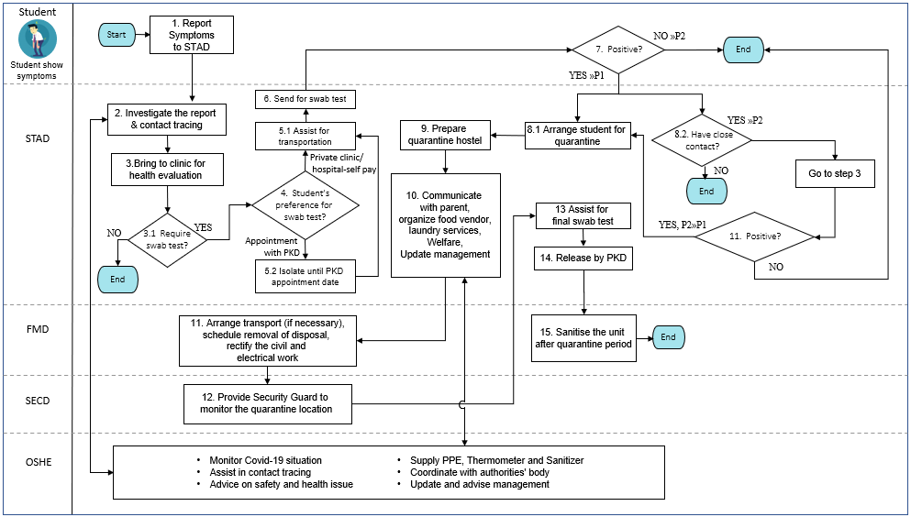
Outbreak Management Process For Student

Slide 26
Student’s Support
For any questions and further information, please contact:
Occupational Safety and Health Unit (OSH)
Student Affairs Division (STAD)
Kesavan A Arumugam
Email: kesavan@mmu.edu.my
(HP) 016 380 1537
Mustapha bin Shukri (STAD Cyberjaya)
Email: Mustapha.shukri@mmu.edu.my
(O) 03-8312 5353
(HP) 011-5930 9808
Nabilla Taryin
Email: nabilla.taryin@mmu.edu.my
(O) 03 8312 5482
Suaidi bin Rahim (STAD Melaka)
Email: suaidi@mmu.edu.my
(O) 06-2523469
(HP) 011-5934 9808
  Or you can email to oshe@mmu.edu.my
Pandemic can be stressful.. Take care of your mental health
The Counselor & Online Psychosocial Support Service
Ms.Nur Ramizah Alasri
Head of Counseling Unit/Counselor
Email: ramizah.alasri@mmu.edy.my
based at Cyberjaya Campus
Ms.Norhidayu Ahmad
Counselor
norhidayu.ahmad@mmu.edu.my
based at Melaka Campus
Mdm.Nurul Ahmal Nawawi
Counselor
ahmal.nawawi@mmu.edu.my
based at Melaka Campus
Reach to us via email in making appointment to 'Meet' online
Alternatively, can reach MOH Emotional Health and Psychological Covid-19 support line
from 8am to 5pm at 011-63996482, 011-63994236 or 03-29359935

Slide 27
Thank You!
Our safety and health are our responsibility. Please comply with all SOPs set by MOH, MOHE, NSC and MMU
#StaySafe #StayHealthy

