Slide 1

Academic English for Postgraduates (AEP)
Register Now!
May 2024 Intake
13 May to 5 July 2024

Slide 2


Open to all Postgraduate Students!
MS Teams
Course Length: 8 weeks (32 hours)
Monday and Wednesday Evening: 6pm to 8pm

Slide 3
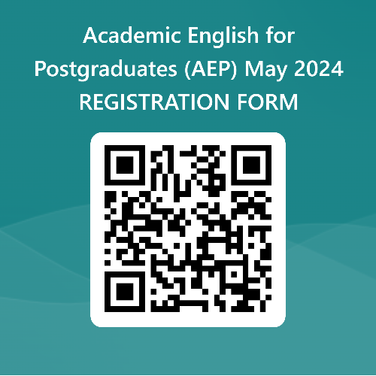
Registration deadline: 8th May 2024
Register Now
[https://forms.office.com/r/pFemKsa6Av]

Slide 4
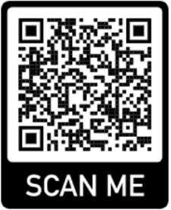
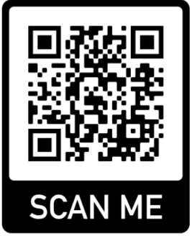

Malaysian (Local Transaction)
Choose Category: Short Course
Event Name: Academic English for
Postgraduates (AEP)
Choose Participant Type: Individual
International
(Transaction outside Malaysia)
Go to: mmulanding.flywire.com
Choose: Conference
Fee:RM1600.
Pay now and secure your seat!

Slide 5
PROGRAMME SCHEDULE: Course Length: 8 weeks (32 hours)
Week | Module | hours per week
Week 1 | Academic Writing for PG Reading and Vocabulary for PG | 2 2
Week 2 | Academic Writing for PG Reading and Vocabulary for PG | 2 2
Week 3 | Academic Writing for PG Reading and Vocabulary for PG | 2 2
Week 4 | Academic Writing for PG Reading and Vocabulary for PG | 2 2

Slide 6
PROGRAMME SCHEDULE: Course Length: 8 weeks (32 hours)
Week | Module | hours per week
Week 5 | Academic Writing for PG Speaking Skills | 2 2
Week 6 | Critical Thinking and Analysis Speaking Skills | 2 2
Week 7 | Critical Thinking and Analysis Speaking Skills | 2 2
Week 8 | Critical Thinking and Analysis Speaking Skills | 2 2

Slide 7

Modules

Slide 8
Module 1:
Academic Writing for PG
Understanding academic writing conventions
Structuring essays, reports, and research papers
Incorporating evidence and citing sources effectively
Grammar in Writing
Tenses
Modal verbs
Writing successful sentences: clause types (relative clauses, noun clauses, gerund clauses, prepositional clauses, adjective clauses, adverb clauses)
Active-Passive sentences
Synthesising, Paraphrasing & Summarising Skills
AI Assisted Writing

Slide 9
Module 2:
Reading and Vocabulary for PG
Active reading strategies
Reading for gist: Skimming
Reading for specific information: Scanning
Distinguishing main idea and supporting details
Differentiating between facts and opinions
Making inferences and drawing conclusions
Analysing and evaluating scholarly texts
Evaluating author’s argument
Evaluating validity and credibility of an argument
Critical synopsis of a text: The five questions
Strategies to Determine the Meaning of Unfamiliar Words
Research jargons: Understanding commonly used terms and concepts
Synthesising information from multiple sources

Slide 10
Module 3:
Speaking Skills
Structuring and designing presentations
Participating in academic discussions and seminars
Delivering effective presentations
Engaging in academic debates and dialogue

Slide 11
Developing critical thinking skills for postgraduate students
• Evaluating arguments and evidence for research purposes
• Constructing reasoned and well-supported arguments
Module 4:
Critical Thinking and Analysis

Slide 12

For more information contact :
Nur Syazana: 013-487 6910
nur.syazana.lyana@mmu.edu.my
Nadia Fariha: 019-654 7861
nadia.fariha@mmu.edu.my
Note: Limited seats available! Register with full payment to secure your seat.

