Slide 1




FIL Briefing
Foundation to Degree (F2D) & Academic Matters
Prepared by:
Ms. Saidatul Nasuha binti Jamaludin
FOUNDATION IN LAW PROGRAMME COORDINATOR

Slide 2

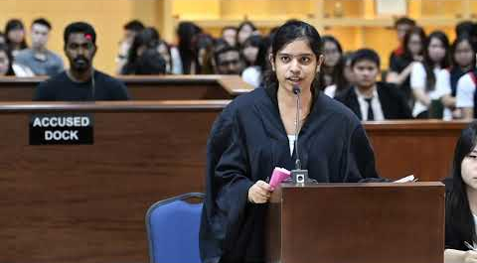
objective
To brief the FIL students about the application to Bachelor of Law in MMU

Slide 3
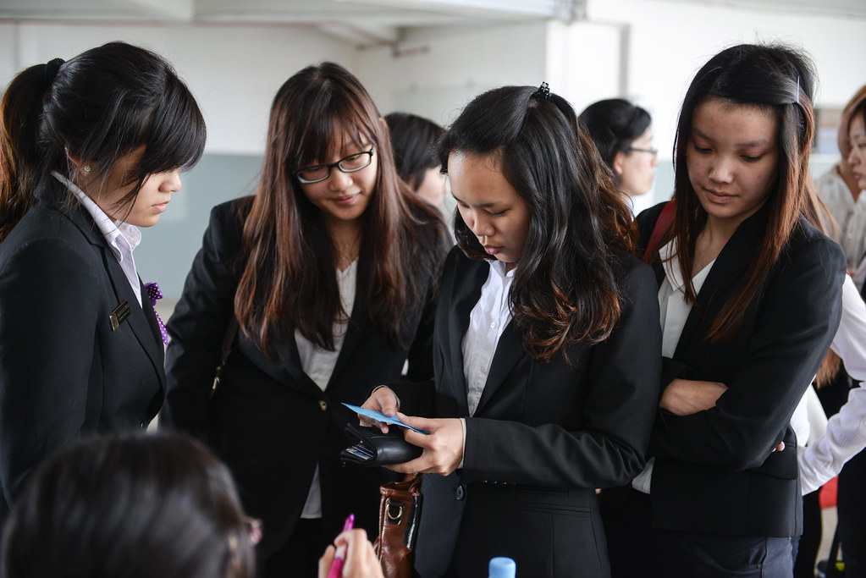
REQUIREMENT TO APPLY
All Foundation in Law students who passed all Tri 1 and Tri 2 subjects
Any student who did not pass Tri 1 and/or Tri 2 subject is not eligible to apply for Law Degree (intake October 2023)
Read More

Slide 4

Trimester 1 | Trimester 2 | Trimester 3
Communicative English Critical Thinking Computer Applications Introduction to Law General Principles of Law Malaysian Legal History | Essential English Fundamentals of Business Management Basic Accounting for Lawyers Introduction to Criminal and Constitutional Law Introduction to Politics and Governance Introduction to Syariah Law | English for Law Law and Society Introduction to Commercial Law

Slide 5

Please alert!
Week | Date (EGT 2310) | To do | Action by
W3 | 21/08/23 -28/08/23 | Briefing for students (completing Foundation & graduating Diploma)
W4 | 29/08/23 | Generate complete list
W4- W7 | 29/08/23 - 24/09/2023 | Application open Student receive email entitled “Application to Degree program” Application guidelines for returning students.pptx Main Menu > Self Service > Application to Degree Student choose degree program | Eligible Completing Foundation Student *Student must alert MMU email and respond on time.
Study week | 25/09/23- 1/10/24 | Faculty to generate the full applicant list, verify the conditional offer and “confirm” then “transfer” to Admission Office
Exam week | 2/10/23-8/10/23 | Issue conditional offer (ADMT of conditional offer)
hello@reallygreatsite.com

Slide 6
TBW 1-2 | 9/10/23- 22/10/23 | Online Offer Acceptance (DEIN process ) | Students
TBW 3 | *Senate: 26/10/2023 *ERU to provide COMP list: 26/10/2023 | Faculties /EXAM furnish Registration Unit the Senate endorsement name list (final sem result)
TBW 3 | 26-27/10/2023 | Issue Actual offer letter
TBW 3 | *MATR/TA/CT: 27/10/2023 | Activate student status (MATR process)
TBW 3 | *28/10/2023 | Subject Registration | Students
W1 | 30/10/2023 | Commencement of New trimester | Students
hello@reallygreatsite.com

Slide 7
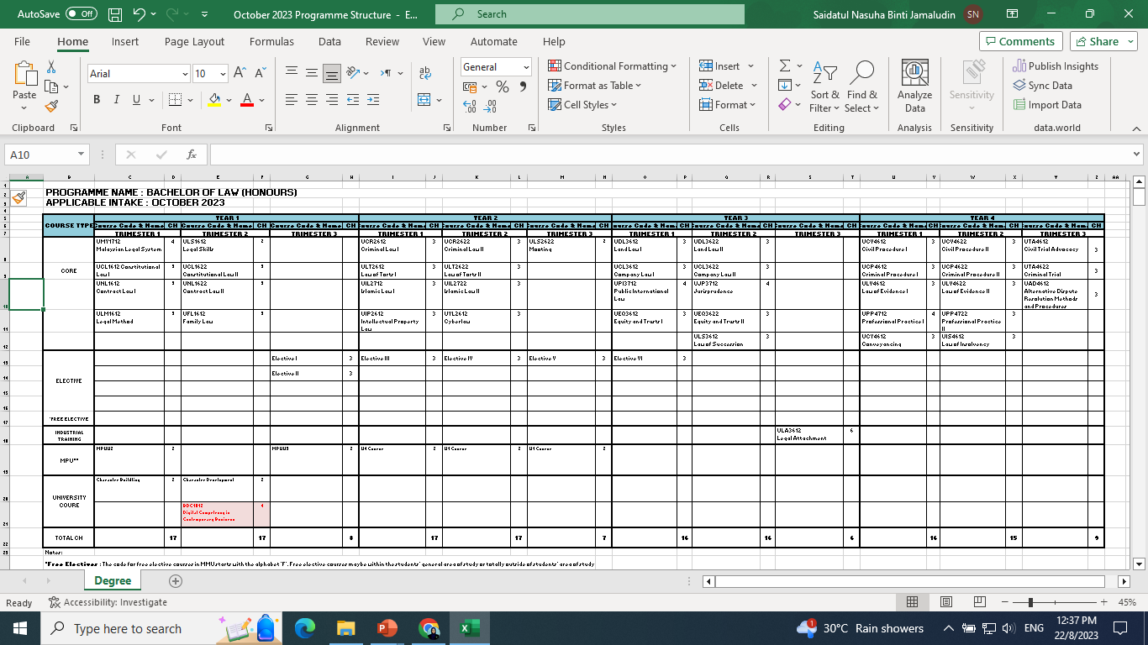
Programme Structure Bachelor of Law (Honours)

Slide 8
Programme Structure Bachelor of Law (Honours)
Programme Structure Bachelor of Law (Honours)
Four-year program
Total credit hours: 161
Subjects' category:
  5 MPU courses – two (2) U1, one each for U2, U3 and U4; (three) 3 University course.
    U1 – Penghayatan Etika dan Peradaban / Falsafah dan Isu Semasa.
    U2 – Bahasa Kebangsaan A/Foreign Language - Character Building I, Character Building II and Leadership Module
    U3 – Introduction to Multicultural Studies in Malaysia/Stress and Well-Being among Malaysians/Islamic Institutions in Malaysia
    U4 – Co-Curriculum

Slide 9
Programme Structure Bachelor of Law (Honours)
Programme Structure Bachelor of Law (Honours)
  (2) 40 Core courses (including Mooting, Legal Attachment)
  (3) 6 Elective courses (4 law electives, 2 non law electives)
Out of the 6 elective courses, students may opt to register for a maximum of two (2) non-law elective courses, which must be 3 credit hours.
Faculty will only offer courses as per the programme structure.
Students who need to repeat any course can only register for the course(s) when the Faculty offers the courses in accordance with the programme structure.

Slide 10
Programme Structure Bachelor of Law (Honours)
Students need to obtain Muet Band 4 to graduate from the programme.
Students must register for ALL courses taken in the Trimester.
Students who fail to register for their courses will not be allowed to sit for their final examination.
Students shall register for all courses in each Trimester according to the Programme Structure.

Slide 11
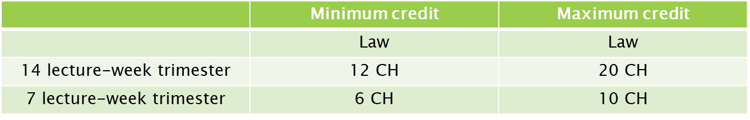
Programme Structure Bachelor of Law (Honours)
Students who fail to follow the Programme Structure are subjected to the minimum and maximum academic load as prescribed below :
A student who does not register any course by week 4 and has not applied for Leave of Absence, his or her status shall be changed to ‘Dismissed’.

Slide 12
ADD/DROP, WITHDRAW & QUIT
ADD/ DROP
Adding and/or dropping any course should be done during the first two weeks of each trimester.
WITHDRAWAL
A student shall be allowed to withdraw from the course that he has registered provided that the prescribed regulation is complied with.
QUIT
Students who decide to cease their studies are required to notify the Examination and Records Unit in writing. Students who fail to do so are liable to pay all fees and other related charges for the entire trimester to MMU.

Slide 13


Any question?
thank
You

Slide 14
Please stay back for awhile!
1 | 1221101336 | ADRIANA QAISARA BINTI AZRIL HAFIZ
2 | 1221100205 | AMBHIGAI SIVALINGAM
3 | 1221100501 | ANUSHRI A/P SIVASUBRAMANIAM
4 | 1221100229 | CARMEN YU HWEE XUAN
5 | 1221100548 | CHONG KAR MUN
6 | 1221100651 | DAHNNICAH DASHSRINA SUSAYAN
7 | 1221100959 | DHIYA SARAHANNA BINTI ROSAL AZIMIN
8 | 1221100729 | DICKY LAU LIH SIONG
9 | 1221101021 | DIVYAREKA A/P T RAMESHEN
10 | 1221100517 | ELIJAH RAJ JOSEPH A/L SUNDARARAJ
11 | 1221100535 | FARAH YASMEEN BINTI NORHISHAM
12 | 1221100203 | HEHLAKSHIKA A/P MALAYARASAN
13 | 1221100286 | IVAN TAN CHUN HUNG
14 | 1221100410 | JANELLE LEONG JAY NIE
15 | 1221100887 | JASMEERAA A/P KUMARAVEL
16 | 1221100210 | JOHN JEREMIAH NATHAN A/L JESU NATHAN
17 | 1221100428 | KHALISH IRFAN BIN KHAIRIZAMAN
18 | 1221100273 | LAM QIAN YU
19 | 1221100247 | LEE SOON WEI
20 | 1221100335 | LEE YI JIE
21 | 1221100209 | LIM ZHAN VIC
22 | 1221100313 | LIOW YEN YI
23 | 1221100238 | LOI ZHONG XUAN
24 | 1221101345 | MARTINA JOLENE AK RUDIE
25 | 1221101766 | MUHAMMAD DAANISH KAMAL BIN MOHAMMED ANSAR
26 | 1221100419 | MUNESSWARAN A/L YAGOO
27 | 1221100536 | NEMISHA A/P PUVANESH
28 | 1221100201 | NOR ALEESIA AMYLIA BINTI DANIEL HAFIDZAN
29 | 1221100612 | NUR FATEEHAH BINTI RAZEELAN
30 | 1221100582 | NUR SYAFIYAH SYAFIQAH BINTI SUHADI
31 | 1221100495 | OH SHI YAN
32 | 1221100222 | ONYINYECHI ARULJOTHI IWUNNA
33 | 1221100496 | OOI KAI XUN
34 | 1221100215 | PUTERA ASYIQ BIN AZLAN
35 | 1221101033 | RANIA HANNANI BINTI ZEIDI
36 | 1221100402 | RUEBEN THIYAGA RAJAN
37 | 1221100336 | SHARANYA A/P GANESAN
38 | 1221100645 | SHIRNIE LAU
39 | 1221101034 | SYED SYAFIQ BIN SYED ABD RAZAK
40 | 1221100249 | TANUJAH NAIR PARTHAN
41 | 1221100412 | THARANI A/P BENJAMIN
42 | 1221100608 | TRESHA A/P S SHANMUGAMNATHA N
43 | 1221100528 | VIVETHAA SRI A/P RAMA DASS ROW
44 | 1221100481 | ZARITH SOFEA BINTI MUHAMMAD ALFI

Slide 15
BRIEFING FOR SPECIAL OFFER intro to syariah law
3 groups of students in this special offer:
(1) Those who failed Intro to Syariah Law only;
  (2) Those who failed Intro to Syariah Law + any subject in Trimester 1;
(3) Those who failed Intro to Syariah Law + and other subject(s) in Trimester 2 + and/or without any subject in Trimester 1

Slide 16
BRIEFING FOR SPECIAL OFFER intro to syariah law
  This is not compulsory for each student to accept this special offer
  Timetable
  Lecturer in charge
  Duration of Week
  Assessments ( MIT, Presentation, Assignment, Final Exam)
  Fill up 2 forms: i) Appeal to Register for Over Credit Hours Limit; ii) Subject Registration Form

Slide 17
Any question?
thank
You

