Slide 1
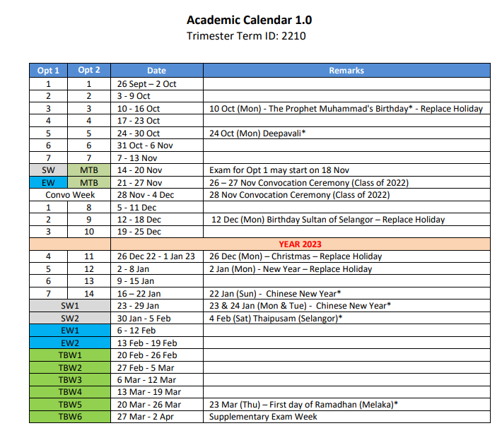
FINAL YEAR PROJECT TRI 1 2022/2023 TIMELINE
Last day Manual Registration (CAMSYS) – strictly for student who sat Supp Exam, Special case student, ) – 23 Oct 2022(Week 4)
Last day of blended learning assessment – 30 Oct 2022 (Week 5)
Submission of research proposal to supervisor - Week 4 (17th – 23 Oct 2022)
Submission of Softcover Report/Turnitin – 19 Dec 2022 (Week 10) – or before your presentation dates
Presentation Days – Week 11 & Week 12 (26 Dec 2022 – 8 Jan 2023
Submission of Hardcover Report – 3rd Feb 2023 (Friday)

