Slide 1

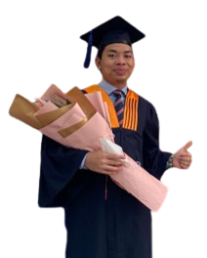
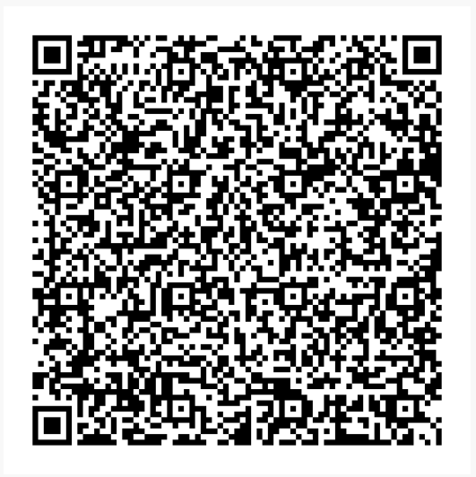


FACULTY OF ENGINEERING & TECHNOLOGY
FET ALUMNI SHARING SESSION
Organised by: FET Alumni Committee
My Journey After MMU
Mr. Muhamad Jalaluddin Jamri
Field Service Engineer,
Cohu Malaysia Sdn. Bhd.
Bachelor of Engineering (Hons) Electronics majoring in Telecommunications
(Class of 2021)
Date: 24 January 2025
(Friday)
Time: 6.00 p.m. – 7.00 p.m.
Online session link:
https://shorturl.at/dgmrx
Scan to join:

