Slide 1

Guideline accessing FET FYP related systems via Virtual Private Network (MMU VPN) for AppleMac, Android and Microsoft platforms
Jan 2024

Slide 2
FET FYP related system to be accessible via MMU intranet only
Due to MMU network security policy issues, FET FYP related systems will be accessible via MMU intranet only starting Jan 2024.
FET FYP related systems are as below:
  FYP portal (http://fet.mmu.edu.my/fyp/)
  FYP admin system (http://fet.mmu.edu.my/~fet-training/FYP/index.php)
  FYP online submission (http://fet.mmu.edu.my/~fet-training/FYP/online/index_files/public_index.php)
  FYP presentation booking (http://fet.mmu.edu.my/~fypv2/booking/staff_login.php)
Hence, if anyone would like to visit FET FYP related systems from outside MMU campus, you need to access via MMU VPN.

Slide 3
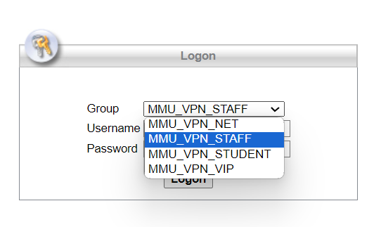
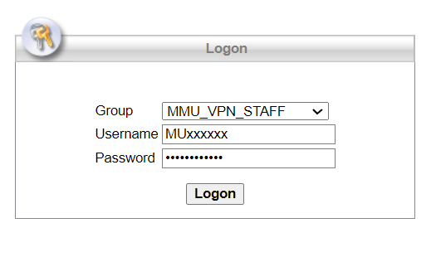
Guideline to connect to MMU VPN (via Microsoft PC)
Please visit MMU VPN portal at https://vpn3.mmu.edu.my
Choose group “MMU_VPN_STAFF” if you are MMU staff, “MMU_VPN_STUDENT” if you are MMU student.
Login in the system using your MMU IDM login credentials.

Slide 4
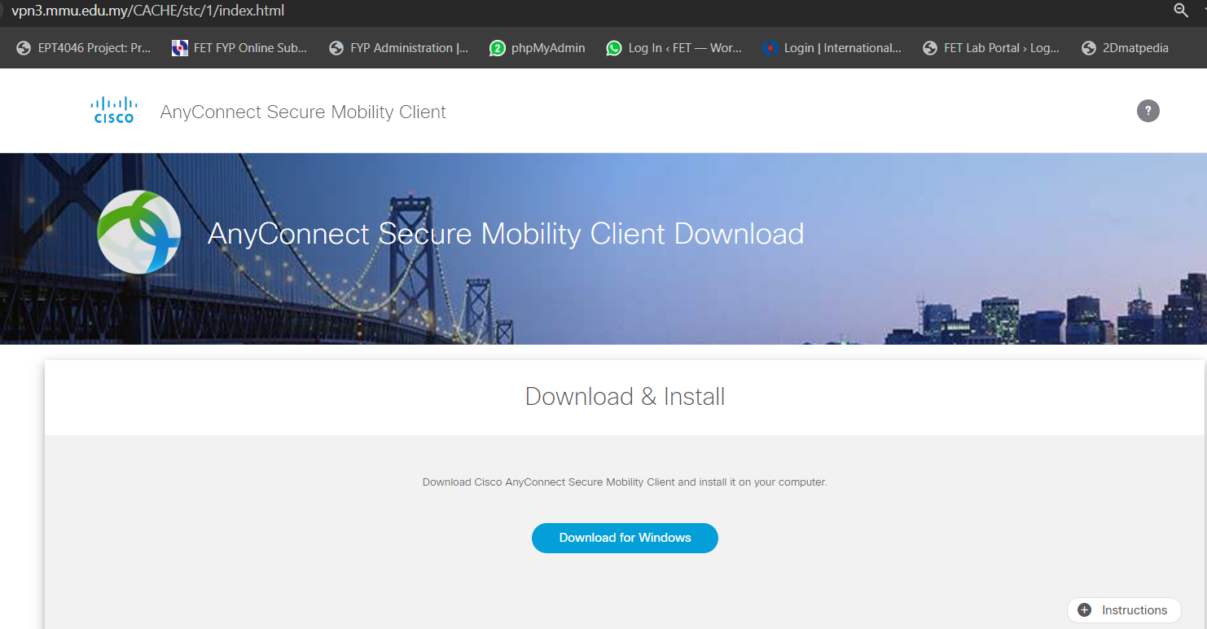
Guideline to connect to MMU VPN (via Microsoft PC)
Download and install the “AnyConnect Secure Mobility Client”

Slide 5
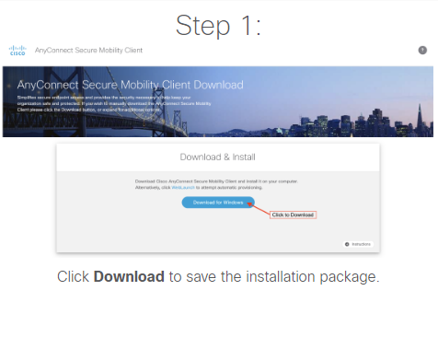
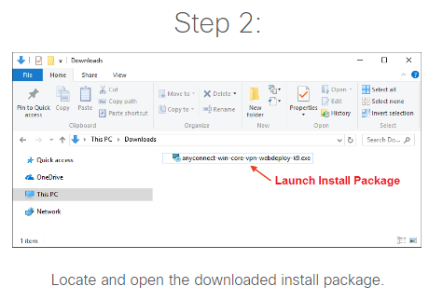
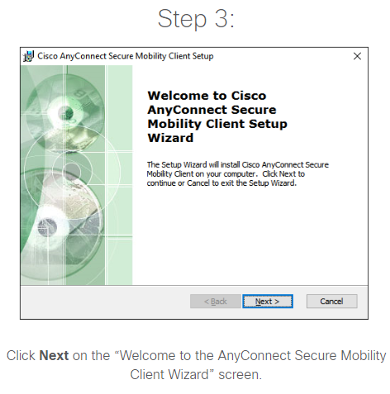
Instruction to install the VPN client

Slide 6
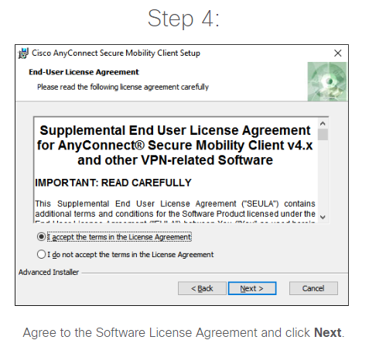
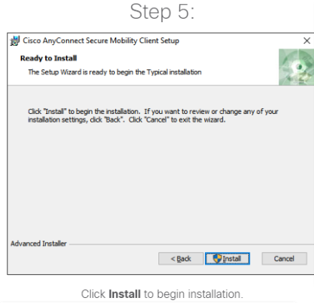
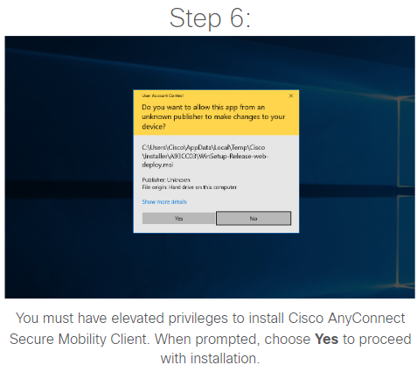
Instruction to install the VPN client

Slide 7
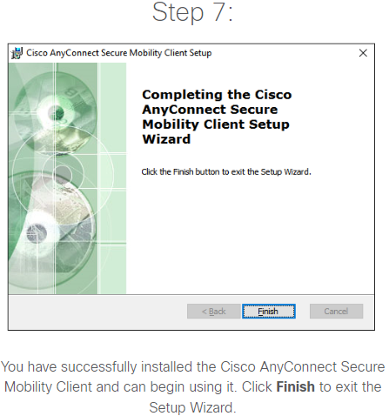
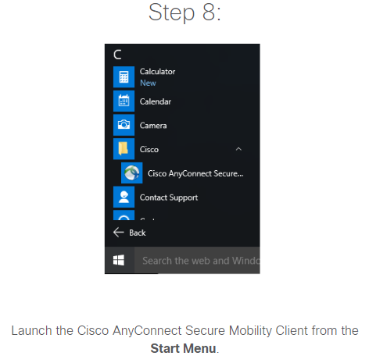
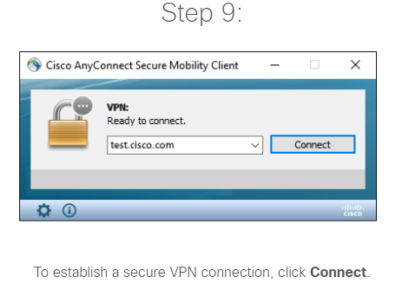
Instruction to install the VPN client

Slide 8
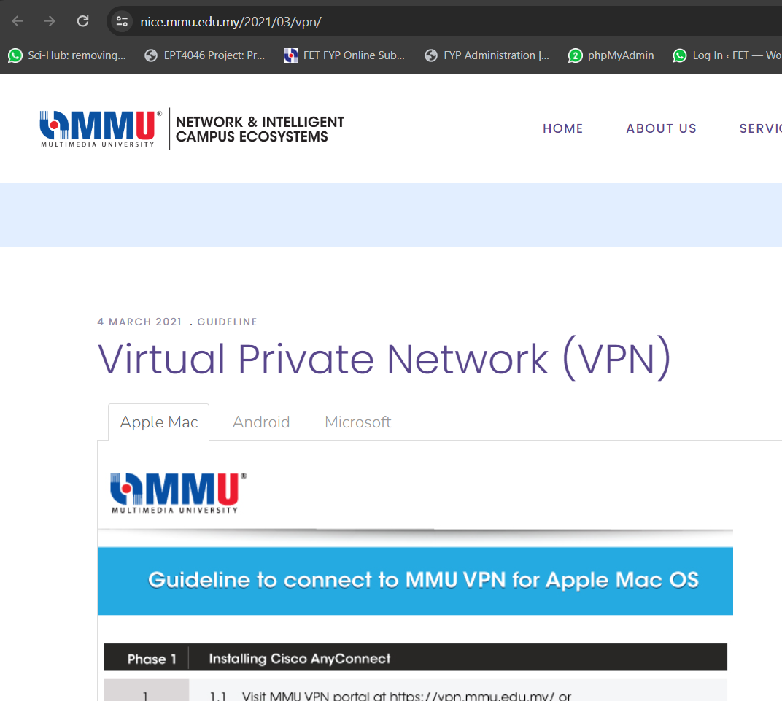
Guideline to connect to MMU VPN (via Microsoft PC)
To install MMU VPN on other devices, please refer to the guideline shared by NICE on the VPN installation for all devices https://nice.mmu.edu.my/2021/03/vpn/
Select your corresponding platform for the guideline

Slide 9
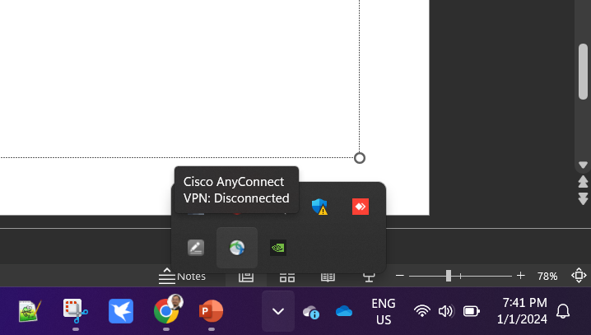
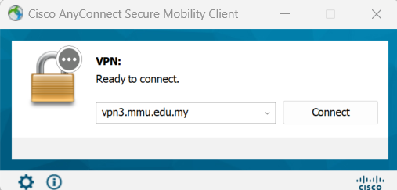
Guideline to connect to MMU VPN (via Microsoft PC)
Once the installation is completed, kindly connect using MMU IDM
1
Click the cisco VPN client from the task bar menu
2
Click connect to initiate the VPN connection via vpn3.mmu.edu.my

Slide 10
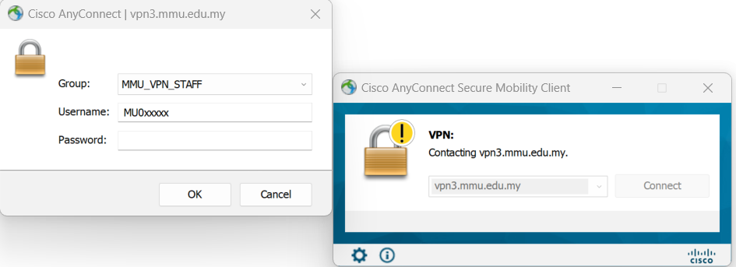
Guideline to connect to MMU VPN (via Microsoft PC)
Once the installation is completed, kindly connect using MMU IDM
3
You will be prompted to login using your MMU IDM.
Note: select MMU_VPN_STUDENT if you are MMU student

Slide 11
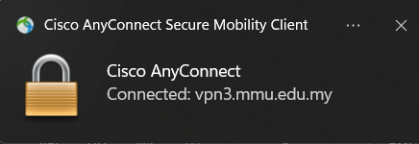
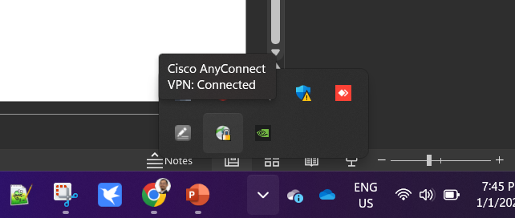
Guideline to connect to MMU VPN (via Microsoft PC)
Once the installation is completed, kindly connect using MMU IDM
4
Once successfully connected to MMU VPN, you should have the connected successful notification
5
If you click on the VPN client icon again, it should show “VPN Connected” message

Slide 12
Guideline to connect to MMU VPN (via Microsoft PC)
When you are connected to MMU VPN, you can visit FET FYP systems by typing their corresponding web addresses (URLs) in your web browser.
  FYP portal (http://fet.mmu.edu.my/fyp/)
  FYP admin system (http://fet.mmu.edu.my/~fet-training/FYP/index.php)
  FYP online submission (http://fet.mmu.edu.my/~fet-training/FYP/online/index_files/public_index.php)
  FYP presentation booking (http://fet.mmu.edu.my/~fypv2/booking/staff_login.php)

Slide 13
Thank you

