Slide 1

MUET

Slide 2

Starting from Session 1 of MUET in 2021, MUET syllabus and test specifications aligned to the Common European Framework of Reference for Languages (CEFR) will be used.

Slide 3
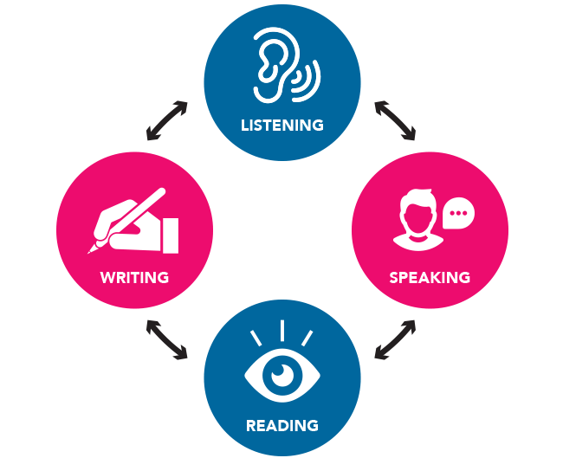
Malaysian University English Test
What is MUET?
Who has to sit for MUET?
STPM candidates, matriculation students, as well as diploma and pre-university students who wish to pursue a first degree program in local universities
MUET is a test of English proficiency for admission to higher education, measuring the ability of test takers to listen, speak, read, and write English in real situations in the education context.

Slide 4
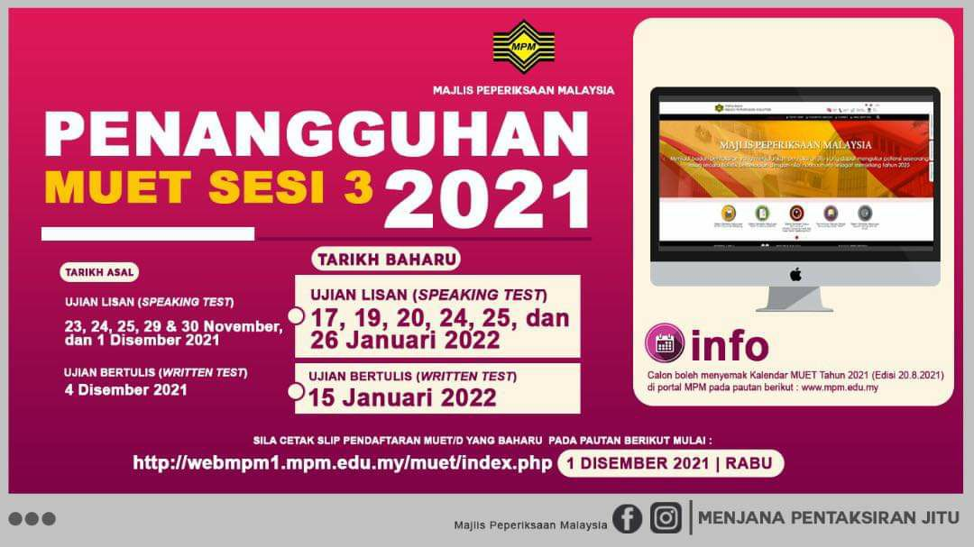

Slide 5
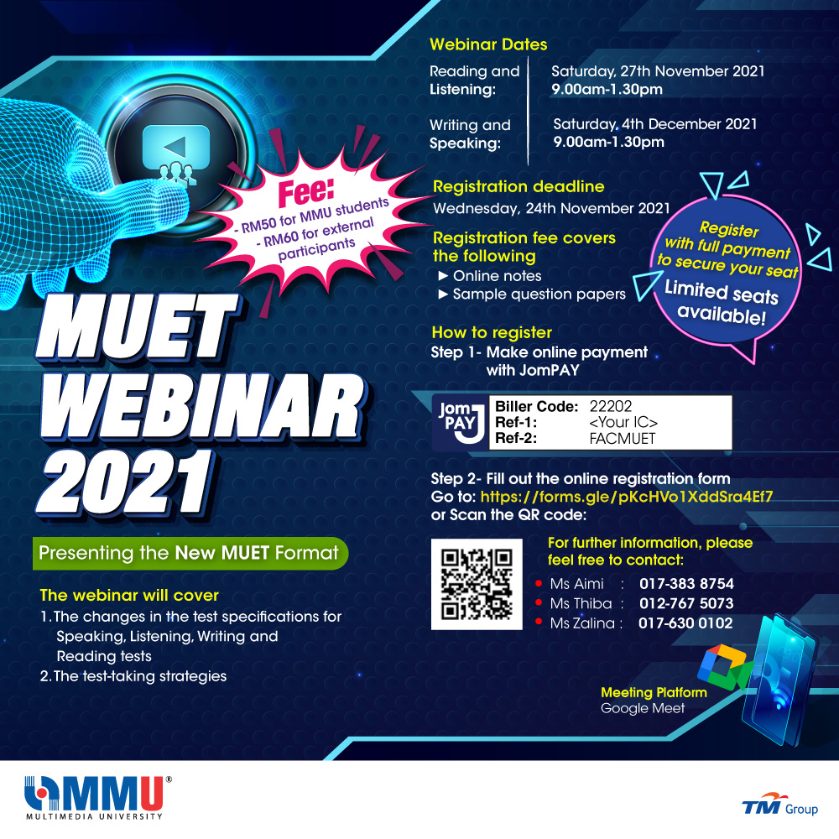

Slide 6

MUET WEBINAR 2021
Webinar Dates
Reading and Listening: Saturday, 27th November 2021│ 9.00am-1.30pm
Writing and Speaking: Saturday, 4th December 2021│9.00am-1.30pm
Fees
RM50 for MMU students
RM60 for external participants

Slide 7
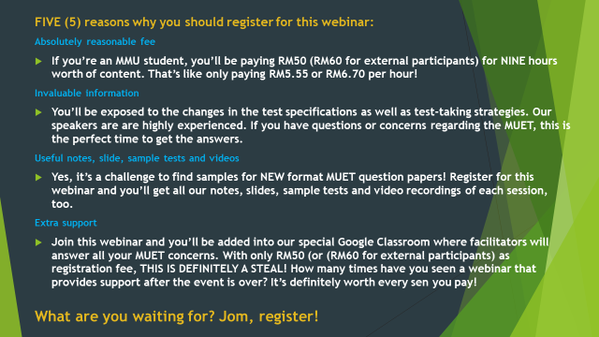

Slide 8

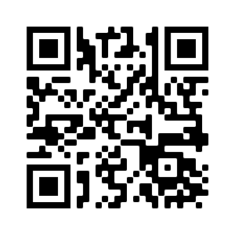
How to register:
Step 1: Make online payment with JomPAY
Biller Code: 22202
Ref-1: <Your IC>
Ref-2: FACMUET
Step 2: Fill out the online registration form.
Go to: https://forms.gle/pKcHVo1XddSra4Ef7
Or
Scan the QR code

