Slide 1
Atos IT Challenge 2022
  The 1st international student competition dedicated
  to technological innovation

Slide 2
01.
About Atos

Slide 3






Atos ID card
#1 in managed security services Europe and
#3 worldwide
105,000 business technologists
in 71 countries worldwide
€11.2 bn revenue and
€1 bn operating margin
c.€235 m R&D
per annum
Worldwide IT Partner
of the Olympic and Paralympic Games
85,000 new
digital certifications
Global leader in cloud and digital workplace
14.9 tCO2/m€ revenue industry best-in-class

Slide 4



Our differentiator
Leading Innovation
Only digital services company to aggressively invest in innovation at scale
Circa €1 billion R&D spend over 4 years, circa 5,000 innovation patents
First company to set up an internal Scientific and expert community
Unmatched Breadth
Only IT company to manage the whole value chain of data
Proven specialized industry-specific solutions and services portfolio
Global presence in 73 countries, circa 110,000 experts worldwide
Trusted Partnership
We invest in trusted long-term relationships
Established world-renowned partnerships with Siemens, Worldline, Google Cloud
Building partnerships with clients and start-ups

Slide 5
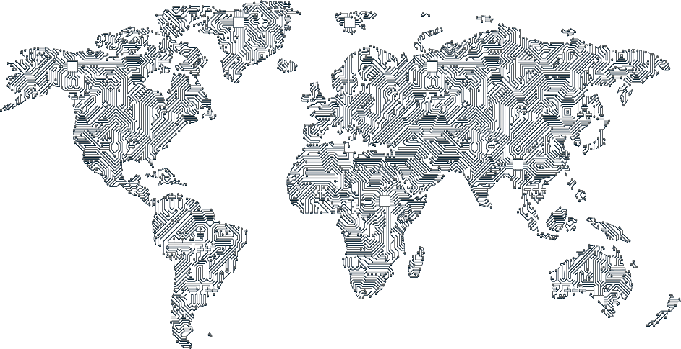
Our international presence
105,000 employees working in 71 countries
Benelux & The Nordics
4,000 employees
Germany
9,000 employees
United Kingdom & Ireland
9,000 employees
Central &
Eastern Europe
12,500 employees
France
13,000 employees
Italy
1,500 employees
Iberia
5,500 employees
North America
10,000 employees
Asia Pacific
34,500 employees
South America
3,000 employees
Middle East & Africa
3,000 employees

Slide 6
02.
Atos IT Challenge 2022

Slide 7




What is the challenge all about?
An international competition
For students from all around the world in Austria, Brazil, China, France, Germany, India, Netherlands, Russia, South Korea, Spain, Turkey, UK, US…
Support for the Student teams from experts in the Scientific Community
To help the students in
developing their ideas
A challenging contest
Challenging not only students innovation qualities but also development and business, offering an unique learning experience
An amazing reward program
1st : 10,000€
2nd : 5,000 €
3rd : 3,000 €
+ Invitation to the Awards Ceremony in Paris
+ Work experience and opportunities
within the Atos Group

Slide 8
Atos IT Challenge 2022 – To the Moon… To Mars… To the Stars
Atos is at the heart of a number of activities in space, including:
Satellite imagery data processing and analytics
Satellite operating systems
Satellite monitoring systems
Providing IT services to Space Agencies
Involvement in special projects such as the experiments performed by Rosetta's Philae Lander on comet 67P/Churyumov–Gerasimenko.
Data of this nature, acquired from space, can be used for projects on planet Earth – supporting agriculture, geographic and topological analysis, meteorology and, increasingly importantly, addressing climate change through decarbonisation.
The application of a variety of technologies and techniques can support student team investigations such as artificial intelligence and machine learning, analytics, image analysis, APIs, and platforms.
There are a wide range of topics that could be explored within this theme, including simulation, communications, analysis of existing data (both imagery and from radio telescopes), object tracking, rocketry, astronomy, astrophysics and more. Earth Observation satellite data is available from a number of sources, including the Sentinel Hub, the Copernicus Open Access Hub, Amazon Web Services and we encourage competition participants to explore the Atos Mundi Web Services Platform with Very High Resolution Satellite Imagery.
We are looking for student teams to develop a mobile or web application in the theme of space that will be of benefit to society at large.

Slide 9
Getting your tickets for the development phase
First jury roadmap
5pts
Alignment with the theme
5pts
Benefit of the service for end-users (Usefulness, novelty)
5pts
Benefit of the service for business partners
5pts
Personal feeling (Originality, I like it…)
5pts
Reality of business model (Feasibility, market size, risks, ...)
5pts
Technical feasibility (Architecture, project plan…)

Slide 10
Challenge Timeline
App Development
Idea Submission
  16th December 2021 – April 2022
  15 Shortlisted teams work on their app development with the help of an Atos coach
Final Jury
  Until 30th November 2021
  Come up with an innovative concept for an application based on our Atos IT Challenge 2021 topic
  May 2022 – June 2022
  The 15 teams pitch their ideas in front of the Final Jury selecting the 3 best teams
First Jury
App Delivery
Awards Ceremony
  December 1st 2021 – December 15th 2021
  First Jury made of the Atos Scientific Community members selects the
  15 best concepts
  April 2022 – May 2022
  App testing in Atos Competence Center
  July 2022
  The 3 finalists are invited to the Awards Ceremony

Slide 12
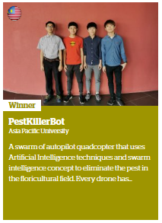
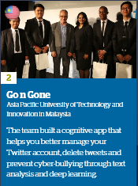
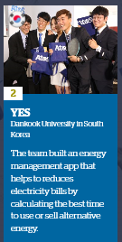
IT Challenge in APAC
Since its creation in 2012, the Atos IT Challenge has empowered students from around the world to develop applications connected to major trends in the digital revolution.
Students in this external competition are mentored by members of Atos Scientific Community for technical and practical support, advice and encouragement.
2016,
2nd Place, Malaysia
2015,
2nd Place, South Korea
2020
1st Prize, Malaysia
A key Atos digital asset

Slide 13
More information
Follow us on:
@AtosITChallenge
#AtosITChallenge
atositchallenge.net
Atos IT Challenge

Slide 14



Join the Atos ITChallenge
Add to your
resume an unique experience that will make the different
Meet professionals, experts, students that will change you
Take the chance to develop your own project and win a great reward

Slide 15
Any questions?
Contact us: itchallenge@atos.net
@AtosITChallenge
facebook.com\AtosITChallenge

Slide 16
Thank you!
For more information please contact:
Deborah.Meddins@atos.net

